Slide 1
Software Project Management UNIT - 1
Dr. K.Jayasri
Associate Professor/IT
GMRIT

Slide 2
Syllabus
UNIT-I
Conventional Software Management: The Waterfall Model, Conventional Software Management Performance.
Transition: The principles of conventional software Engineering, Principles of Modern software management, transitioning to an iterative process.
Evolution of Software Economics: Software Economics, Software Cost Estimation. Improving Software Economics: Reducing Software Product Size, Improving Software Processes, Improving Team Effectiveness, Improving Automation, Achieving Required Quality, Peer Inspections.
Software Development Phases, Procedural vs Object Oriented Paradigm.
Unit II
Life Cycle Phases: Engineering and Production Stages, Inception, Elaboration, Construction, Transition Phases.
Artifacts of Software Process: The Artifact Sets, Types of Artifacts.
Software Architectures: A Management Perspective and Technical Perspective,
Workflows of the process: Software Process Workflows, Iteration Workflows.
Off-the-Shelf Components, Requirement Specification Document. Methods of Specification.

Slide 3
Unit III
Checkpoints of the Process: Major Milestones, Minor Milestones, Periodic Status Assessments. Iterative Process Planning: Work breakdown Structures, Planning Guidelines, Cost and Schedule Estimating process, Iteration Planning Process.
Project Organizations and Responsibilities: Line-of-Business Organizations, Project Organizations, Evolution of Organizations. Process Automation: Automation Building Blocks, The Project Environment.
CASE Tools for Requirements Specification, Planning and Estimation, Pragmatic Planning.
Unit IV
Project control and Process Instrumentation: The Seven Core Metrics, Management Indicators, Quality Indicators, Life Cycle Expectations, Pragmatic Software Metrics, Metrics Automation, Tailoring the Process. Future Software Project Management: Modern Project Profiles, Next Generation Software Economics, The COCOMO Cost Estimation Model: Basic COCOMO
Bugs of Testing, Bug Tracking Tool

Slide 4
Software Project Management
The job pattern of an IT company engaged in software development can be seen split in two parts:
Software Creation
Software Project Management

Slide 5
Project
A project is well-defined task, which is a collection of
several operations done in order to achieve a goal (for
example, software development and delivery). A Project
can be characterized as:
Every project may has a unique and distinct goal.
Project is not routine activity or day-to-day operations.
Project comes with a start time and end time.
Project ends when its goal is achieved hence it is a temporary phase in the lifetime of an organization.
Project needs adequate resources in terms of time, manpower, finance, material and knowledge-bank.

Slide 6
Software Project
A Software Project is the complete procedure of software development from requirement gathering to testing and maintenance, carried out according to the execution methodologies, in a specified period of time to achieve intended software product.

Slide 7
Need of software project management
Software is said to be an intangible product. Software development is a kind of all new stream in world business and there’s very little experience in building software products.
Most software products are tailor made to fit client’s requirements.
The most important is that the underlying technology changes and advances so frequently and rapidly that experience of one product may not be applied to the other one.
All such business and environmental constraints bring risk in software development hence it is essential to manage software projects efficiently.

Slide 8
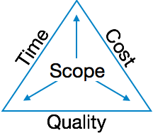
Need of software project management
The image above shows triple constraints for software projects.
It is an essential part of software organization to deliver quality product, keeping the cost within client’s budget constrain and deliver the project as per scheduled.
There are several factors, both internal and external, which may impact this triple constrain triangle. Any of three factor can severely impact the other two.
Therefore, software project management is essential to incorporate user requirements along with budget and time constraints.

Slide 9
Software project manager
A software project manager is a person who undertakes the responsibility of executing the software project.
Software project manager is thoroughly aware of all the phases of SDLC that the software would go through.
Project manager may never directly involve in producing the end product but he controls and manages the activities involved in production.
A project manager closely monitors the development process, prepares and executes various plans, arranges necessary and adequate resources, maintains communication among all team members in order to address issues of cost, budget, resources, time, quality and customer satisfaction.

Slide 10
Software project manager
Let us see few responsibilities that a
project manager shoulders –
Managing People
Act as project leader
Liaison with stakeholders
Managing human resources
Setting up reporting hierarchy etc.

Slide 11
Software project manager
Managing Project
Defining and setting up project scope
Managing project management activities
Monitoring progress and performance
Risk analysis at every phase
Take necessary step to avoid or come out of problems
Act as project spokesperson

Slide 12
Software Management Activities
Software project management comprises of a number of activities, which contains planning of project, deciding scope of software product, estimation of cost in various terms, scheduling of tasks and events, and resource management. Project management activities may include:
Project Planning
Scope Management
Project Estimation

Slide 13
Software Management Activities
Project Planning
Software project planning is task, which is performed before the production of software actually starts.
It is there for the software production but involves no concrete activity that has any direction connection with software production.
it is a set of multiple processes, which facilitates software production

Slide 14
Software Management Activities
Scope Management
It defines the scope of project; this includes all the activities, process need to be done in order to make a deliverable software product.
Scope management is essential because it creates boundaries of the project by clearly defining what would be done in the project and what would not be done.
This makes project to contain limited and quantifiable tasks, which can easily be documented and in turn avoids cost and time overrun.

Slide 15
Software Management Activities
Scope Management
During Project Scope management, it is
necessary to –
Define the scope
Decide its verification and control
Divide the project into various smaller parts for ease of management.
Verify the scope
Control the scope by incorporating changes to the scope

Slide 16
Software Management Activities
Project Estimation
For an effective management accurate estimation of various measures is a must. With correct estimation managers can manage and control the project more efficiently and effectively. Project estimation may involve the following:
1.Software size estimation :
Software size may be estimated either in terms of KLOC (Kilo Line of Code) or by calculating number of function points in the software.
Lines of code depend upon coding practices and Function points vary according to the user or software requirement.

Slide 17
Software Management Activities
Project Estimation
2. Effort estimation:
The managers estimate efforts in terms of personnel requirement and man-hour required to produce the software.
For effort estimation software size should be known.
This can either be derived by managers’ experience, organization’s historical data or software size can be converted into efforts by using some standard formulae.

Slide 18
Software Management Activities
Project Estimation
3.Time estimation
Once size and efforts are estimated, the time required to produce the software can be estimated.
Efforts required is segregated into sub categories as per the requirement specifications and interdependency of various components of software.
Software tasks are divided into smaller tasks, activities or events by Work Breakthrough Structure (WBS).
The tasks are scheduled on day-to-day basis or in calendar months.
The sum of time required to complete all tasks in hours or days is the total time invested to complete the project.

Slide 19
Software Management Activities
Project Estimation
4. Cost estimation :
This might be considered as the most difficult of all because it
depends on more elements than any of the previous ones. For
estimating project cost, it is required to consider –
Size of software
Software quality
Hardware
Additional software or tools, licenses etc.
Skilled personnel with task-specific skills
Travel involved
Communication
Training and support

Slide 20
Principles of conventional software Engineering
Make quality
Quality must be quantified and mechanisms put into place to motivate its achievement
High-quality software is possible.
Techniques that have been demonstrated to increase quality include involving the customer, prototyping, simplifying design, conducting inspections, and hiring the best people
Give products to customers early.
No matter how hard you try to learn users' needs during the requirements phase, the most effective way to determine real needs is to give users a product and let them play with it.

Slide 21
Principles of conventional software Engineering
Determine the problem before writing the requirements.
When faced with what they believe is a problem, most engineers rush to offer a solution. Before you try to solve a problem, be sure to explore all the alternatives and don't be blinded by the obvious solution
.Evaluate design alternatives.
After the requirements are agreed upon, you must examine a variety of architectures and algorithms. You certainly do not want to use” architecture" simply because it was used in the requirements specification.
Use an appropriate process model.
Each project must select a process that makes ·the most sense for that project on the basis of corporate culture, willingness to take risks, application area, volatility of requirements, and the extent to which requirements are well understood.

Slide 22
Principles of conventional software Engineering
Use different languages for different phases.
Our industry's eternal thirst for simple solutions to complex problems has driven many to declare that the best development method is one that uses the same notation throughout the life cycle.
Minimize intellectual distance.
To minimize intellectual distance, the software's structure should be as close as possible to the real-world structure.
Put techniques before tools.
An undisciplined software engineer with a tool becomes a dangerous, undisciplined software engineer.

Slide 23
Principles of conventional software Engineering
Get it right before you make it faster.
It is far easier to make a working program run faster than it is to make a fast program work. Don't worry about optimization during initial coding.
Inspect code.
Inspecting the detailed design and code is a much better way to find errors than testing.
Good management is more important than good technology.
Good management motivates people to do their best, but there are no universal "right" styles of management.

Slide 24
Principles of conventional software Engineering
People are the key to success.
Highly skilled people with appropriate experience, talent, and training are key.
Follow with care.
Just because everybody is doing something does not make it right for you. It may be right, but you must carefully assess its applicability to your environment.
Take responsibility.
When a bridge collapses we ask, "What did the engineers do wrong?" Even
when software fails, we rarely ask this.
The fact is that in any engineering discipline, the best methods can be used to
produce awful designs, and the most antiquated methods to produce elegant
designs.

Slide 25
Principles of conventional software Engineering
Understand the customer's priorities.
It is possible the customer would tolerate 90% of the functionality delivered late if they could have 10% of it on time.
The more they see, the more they need.
The more functionality (or performance) you provide a user, the more functionality (or performance) the user wants.
Plan to throw one away.
One of the most important critical success factors is whether or not a product is entirely new. Such brand-new applications, architectures, interfaces, or algorithms rarely work the first time

Slide 26
Principles of conventional software Engineering
Design for change.
The architectures, components, and specification techniques you use must accommodate change.
Design without documentation is not design.
I have often heard software engineers say, "I have finished the design. All that is left is the documentation. "
Use tools, but be realistic.
Software tools make their users more efficient.

Slide 27
Principles of conventional software Engineering
Avoid tricks.
Many programmers love to create programs with tricks constructs that perform a function correctly, but in an obscure way. Show the world how smart you are by avoiding tricky code.
Encapsulate.
Information-hiding is a simple, proven concept that results in software that is easier to test and much easier to maintain.
Use coupling and cohesion.
Coupling and cohesion are the best ways to measure software's inherent maintainability and adaptability

Slide 28
Principles of conventional software Engineering
Use the McCabe complexity measure.
Although there are many metrics available to report the inherent complexity of software, none is as intuitive and easy to use as Tom McCabe's.
Don't test your own software.
Software developers should never be the primary testers of their own software.
Analyze causes for errors.
It is far more cost-effective to reduce the effect of an error by preventing it than it is to find and fix it. One way to do this is to analyze the causes of errors as they are detected

Slide 29
Principles of conventional software Engineering
Realize that software's entropy increases.
Any software system that undergoes continuous change will grow in complexity and will become more and more disorganized.
People and time are not interchangeable.
Measuring a project solely by person-months makes little sense.
Expect excellence.
Your employees will do much better if you have high expectations for them.

Slide 30
Principles of Modern Software Management
Base the process on an architecture-first approach.
This requires that a demonstrable balance be achieved among the driving requirements, the architecturally significant design decisions, and the lifecycle plans before the resources are committed for full-scale development.
Establish an iterative life-cycle process that confronts risk early
.
With today's sophisticated software systems, it is not possible to define the entire problem, design the entire solution, build the software, and then test the end product in sequence.
Instead, an iterative process that refines the problem understanding, an effective solution, and an effective plan over several iterations encourages a balanced treatment of all stakeholder objectives.
Major risks must be addressed early to increase predictability and avoid expensive downstream scrap and rework.

Slide 31
Principles of Modern Software Management
Transition design methods to emphasize component-based development.
Moving from a line-of code mentality to a component-based mentality is necessary to reduce the amount of human-generate source code and custom development.
Establish a change management environment.
The dynamics of iterative development, including concurrent workflows by different teams working on shared artifacts, necessitates objectively controlled baselines.

Slide 32
Principles of Modern Software Management
Enhance change freedom through tools that support round-trip engineering.
Round-trip engineering is the environment support necessary to automate and synchronize engineering information in different formats(such as requirements specifications, design models, source code, executable code, test cases).
Capture design artifacts in rigorous, model-based notation.
A model based approach (such as UML) supports the evolution of semantically rich graphical and textual design notations.

Slide 33
Principles of Modern Software Management
Instrument the process for objective quality control and progress assessment.
Life-cycle assessment of the progress and the quality of all intermediate products must be integrated into the process.
Use a demonstration-based approach to assess intermediate artifacts.

Slide 34
Principles of Modern Software Management
Plan intermediate releases in groups of usage scenarios with evolving levels of detail.
It is essential that the software management process drive toward early and continuous demonstrations within the operational context of the system, namely its use cases.
Establish a configurable process that is economically scalable.
No single process is suitable for all software developments.

Slide 35
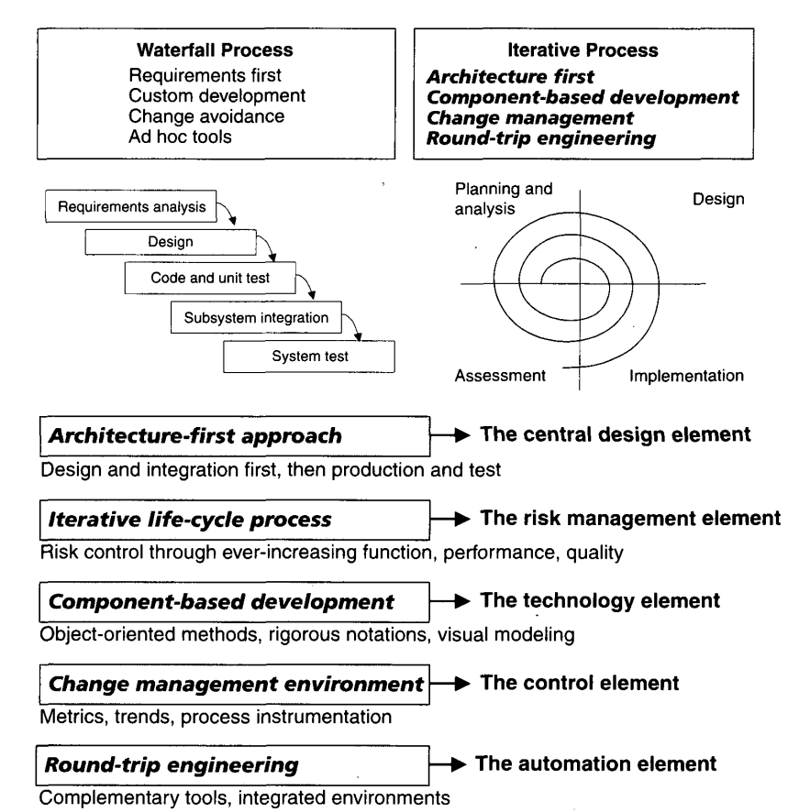
Principles of Modern Software Management (Top 5 Principles)

Slide 36
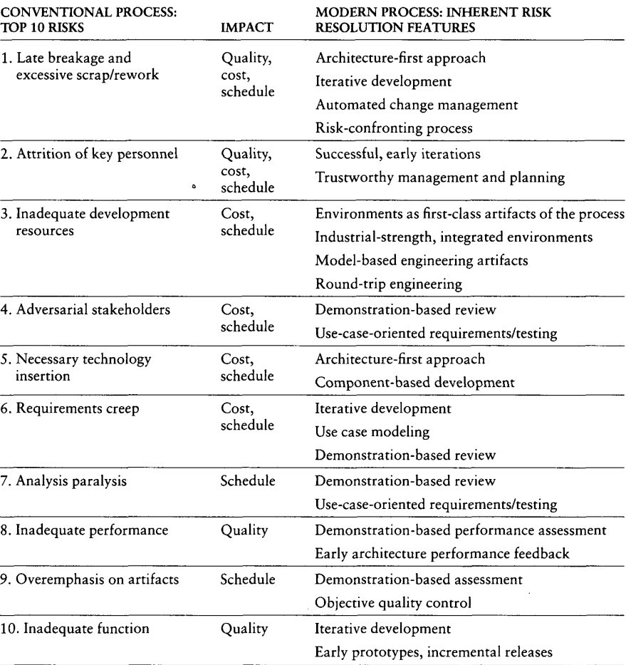
Modern Process Approaches for Solving Conventional Problem

Slide 37
TRANSITIONING TO AN ITERATIVE PROCESS
Modern software development processes have moved away from the conventional waterfall model, in which each stage of the development process is dependent on completion of the previous stage.
The economic benefits inherent in transitioning from the conventional waterfall model to an iterative development process are significant but difficult to quantify.
As one benchmark of the expected economic impact of process improvement, consider the process exponent parameters of the COCOMO II model

Slide 38
TRANSITIONING TO AN ITERATIVE PROCESS
This exponent can range from 1.01 (virtually no diseconomy of scale) to 1.26 (significant diseconomy of scale).
The parameters that govern the value of the process exponent are application precedentedness, process flexibility, architecture risk resolution, team cohesion, and software process maturity.
The following paragraphs map the process exponent parameters of CO COMO II to my top 10 principles of a modern process.

Slide 39
TRANSITIONING TO AN ITERATIVE PROCESS
Application precedentedness. Domain experience is a critical factor in understanding how to plan and execute a software development project.
For unprecedented systems, one of the key goals is to confront risks and establish early precedents, even if they are incomplete or experimental.
This is one of the primary reasons that the software industry has moved to an iterative life-cycle process.
Early iterations in the life cycle establish precedents from which the product, the process, and the plans can be elaborated in evolving levels of detail.

Slide 40
TRANSITIONING TO AN ITERATIVE PROCESS
Process flexibility. Development of modern software is characterized by such a broad solution space and so many interrelated concerns that there is a paramount need for continuous incorporation of changes.
These changes may be inherent in the problem understanding, the solution space, or the plans.
Project artifacts must be supported by efficient change management commensurate with project needs.
A configurable process that allows a common framework to be adapted across a range of projects is necessary to achieve a software return on investment.

Slide 41
TRANSITIONING TO AN ITERATIVE PROCESS
Architecture risk resolution. Architecture-first development is a crucial theme underlying a successful iterative development process.
A project team develops and stabilizes architecture before developing all the components that make up the entire suite of applications components.
An architecture-first and component-based development approach forces the infrastructure, common mechanisms, and control mechanisms to be elaborated early in the life cycle and drives all component make/buy decisions into the architecture process.

Slide 42
TRANSITIONING TO AN ITERATIVE PROCESS
Team cohesion. Successful teams are cohesive, and cohesive teams are successful.
Successful teams and cohesive teams share common objectives and priorities.
Advances in technology (such as programming languages, UML, and visual modeling) have enabled more rigorous and understandable notations for communicating software engineering information, particularly in the requirements and design artifacts that previously were ad hoc and based completely on paper exchange.
These model-based formats have also enabled the round-trip engineering support needed to establish change freedom sufficient for evolving design representations.

Slide 43
TRANSITIONING TO AN ITERATIVE PROCESS
Software process maturity. The Software Engineering Institute's Capability Maturity Model (CMM) is a well-accepted benchmark for software process assessment.
One of key themes is that truly mature are enabled through an integrated environment that provides the appropriate level of automation to instrument the process for objective quality control.

Slide 44
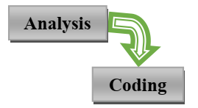
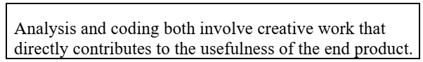
The Waterfall Model
Most software engineering texts present the waterfall model as the source of the
"conventional" software process.
IN THEORY
It provides an insightful and concise summary of conventional software management.
Three main primary points are
1. There are two essential steps common to the development of computer programs: analysis and coding.
Waterfall Model part 1: The two basic steps to building a program.

Slide 45
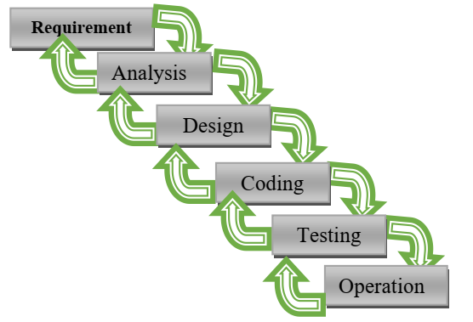
The Waterfall Model
2. In order to manage and control all of the intellectual freedom associated with software development, one must introduce several other "overhead" steps, including system requirements definition, software requirements definition, program design, and testing. These steps supplement the analysis and coding steps. Below Figure illustrates the resulting project profile and the basic steps in developing a large-scale program.

Slide 46
The Waterfall Model
3. The basic framework described in the waterfall model is risky and invites failure.
The testing phase that occurs at the end of the development cycle is the first event for which timing, storage, input/output transfers, etc., are experienced as distinguished from analyzed.
The resulting design changes are likely to be so disruptive that the software requirements upon which the design is based are likely violated. Either the requirements must be modified or a substantial design change is warranted.

Slide 47
The Waterfall Model
Five necessary improvements for waterfall model
Program design comes first
Insert a preliminary program design phase between the software requirements generation phase and the analysis phase.
By this technique, the program designer assures that the software will not fail because of storage, timing, and continuous change.

Slide 48
The Waterfall Model
Document the design.
The amount of documentation required on most software programs is quite a lot, certainly much more than most programmers, analysts, or program designers are willing to do if left to their own devices.
Why do we need so much documentation?
(1) Each designer must communicate with interfacing designers, managers, and possibly customers.
(2) During early phases, the documentation is the design.
(3) The real monetary value of documentation is to support later modifications by a separate test team, a separate maintenance team, and operations personnel who are not software literate.

Slide 49
The Waterfall Model
Do it twice.
If a computer program is being developed for the first time, arrange matters so that the version finally delivered to the customer for operational deployment is actually the second version in so far as critical design/operations are concerned.
Note that this is simply the entire process done in miniature, to a time scale Requirement Analysis, Design, Coding, Testing, Operation that is relatively small with respect to the overall effort.
In the first version, the team must have a special broad competence where they can quickly sense trouble spots in the design, model them, model alternatives, forget the straightforward aspects of the design that aren't worth studying at this early point, and, finally, arrive at an error-free program.

Slide 50
The Waterfall Model
Plan, control, and monitor testing.
Without question, the biggest user of project resources-manpower, computer time, and/or management judgment-is the test phase.
This is the phase of greatest risk in terms of cost and schedule. It occurs at the latest point in the schedule, when backup alternatives are least available, if at all.
The previous three recommendations were all aimed at uncovering and solving problems before entering the test phase.

Slide 51
The Waterfall Model
Involve the customer.
It is important to involve the customer in a formal way so that he has committed himself at earlier points before final delivery.
There are three points following requirements definition where the insight, judgment, and commitment of the customer can bolster the development effort.
These include a "preliminary software review" following the preliminary program design step, a sequence of "critical software design reviews" during program design, and a "final software acceptance review". .

Slide 52
The Waterfall Model
IN PRACTICE
Some software projects still practice the conventional software management approach.
It is useful to summarize the characteristics of the conventional process as it has typically been applied, which is not necessarily as it was intended.
Projects destined for trouble frequently exhibit the following symptoms:
• Protracted integration and late design breakage. • Late risk resolution. • Requirements-driven functional decomposition. • Adversarial (conflict or opposition) stakeholder relationships. • Focus on documents and review meetings. .

Slide 53
The Waterfall Model
Protracted Integration and Late Design Breakage
For a typical development project that used a waterfall model management process. Progress is defined as percent coded, that is, demonstrable in its target form.
The following sequence was common:
• Early success via paper designs and thorough (often too thorough)
briefings. • Commitment to code late in the life cycle. • Integration nightmares (unpleasant experience) due to unforeseen
implementation issues and interface ambiguities. • Heavy budget and schedule pressure to get the system working. • Late shoe-homing of no optimal fixes, with no time for redesign. • A very fragile, unmentionable product delivered late. .

Slide 54
Conventional Software Management Performance
Barry Boehm's "Industrial Software Metrics Top 10 List” is a good, objective characterization of the state of software development.
Finding and fixing a software problem after delivery costs 100 times more than finding and fixing the problem in early design phases.
You can compress software development schedules 25% of nominal, but no more.
For every $1 you spend on development, you will spend $2 on maintenance.
Software development and maintenance costs are primarily a function of the number of source lines of code.
Variations among people account for the biggest differences in software productivity.

Slide 55
Conventional Software Management Performance Barry Boehm's "Industrial Software Metrics Top 10 List” is a good, objective characterization of the state of software development. (Cont..)
6. The overall ratio of software to hardware costs is still growing. In 1955 it was 15:85; in 1985, 85:15.
7. Only about 15% of software development effort is devoted to programming.
8. Software systems and products typically cost 3 times as much per SLOC as individual software programs. Software-system products (i.e., system of systems) cost 9 times as much.
9. Walkthroughs catch 60% of the errors
10. 80% of the contribution comes from 20% of the contributors.

Slide 56
Software Economics
Most software cost models can be abstracted into a function of five basic parameters: size, process, personnel, environment, and required quality.
The size of the end product (in human-generated components), which is typically quantified in terms of the number of source instructions or the number of function points required to develop the required functionality
The process used to produce the end product, in particular the ability of the process to avoid non value-adding activities (rework, bureaucratic delays, communications overhead)

Slide 57
Software Economics
The capabilities of software engineering personnel, and particularly their experience with the computer science issues and the applications domain issues of the project
The environment, which is made up of the tools and techniques available to support efficient software development and to automate the process
The required quality of the product, including its features, performance, reliability, and adaptability

Slide 58
Software Economics
The relationships among these parameters and the estimated cost can be written as follows:
Effort = (Personnel) (Environment) (Quality) ( Size process)
One important aspect of software economics (as represented within today's software cost models) is that the relationship between effort and size exhibits a diseconomy of scale.
The diseconomy of scale of software development is a result of the process exponent being greater than 1.0. Contrary to most manufacturing processes, the more software you build, the more expensive it is per unit item

Slide 59
Software Economics
The three generations of software development are defined as follows:
1) Conventional: 1960s and 1970s, craftsmanship. Organizations used custom tools, custom processes, and virtually all custom components built in primitive languages. Project performance was highly predictable in that cost, schedule, and quality objectives were almost always underachieved.
2) Transition: 1980s and 1990s, software engineering. Organizattions used more-repeatable processes and off the-shelf tools, and mostly (>70%) custom components built in higher level languages. Some of the components (<30%) were available as commercial products, including the operating system, database management system, networking, and graphical user interface.
3) Modern practices: 2000 and later, software production. This book's philosophy is rooted in the use of managed and measured processes, integrated automation environments, and mostly (70%) off-the-shelf components. Perhaps as few as 30% of the components need to be custom built .

Slide 60
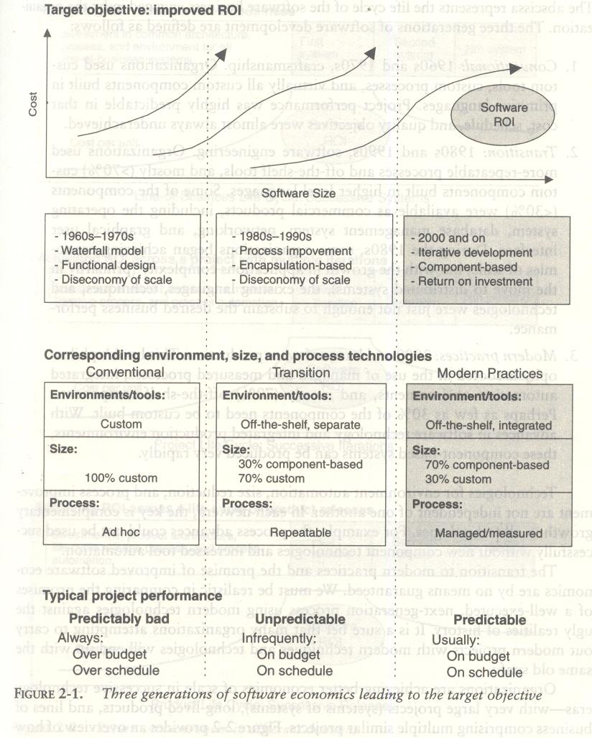

Slide 61
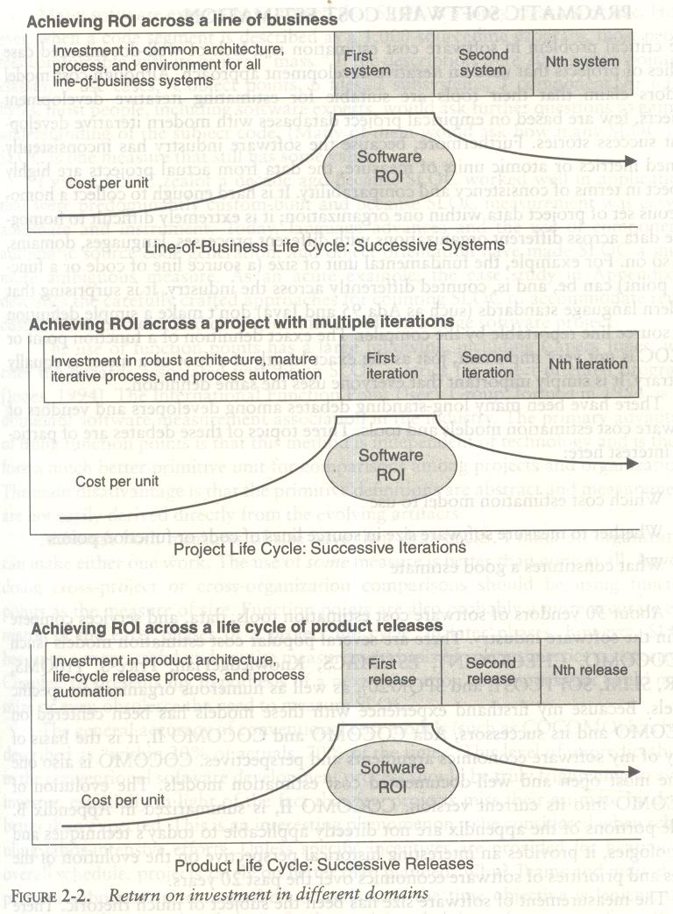

Slide 62
Pragmatic Software Cost Estimation
One critical problem in software cost estimation is a lack of well-documented case studies of projects that used an iterative development approach.
Software industry has inconsistently defined metrics or atomic units of measure, the data from actual projects are highly suspect in terms of consistency and comparability.
It is hard enough to collect a homogeneous set of project data within one organization; it is extremely difficult to homogenize data across different organizations with different processes, languages, domains, and so on.

Slide 63
Pragmatic Software Cost Estimation
There have been many debates among developers and vendors of software cost estimation models and tools.
Three topics of these debates are of particular interest here:
1. Which cost estimation model to use? 2. Whether to measure software size in source lines of code or function points. 3. What constitutes a good estimate?

Slide 64
Pragmatic Software Cost Estimation
There are several popular cost estimation models (such as COCOMO, CHECKPOINT, ESTIMACS, Knowledge Plan, Price-S, ProQMS, SEER, SLIM, SOFTCOST, and SPQR/20), CO COMO is also one of the most open and well-documented cost estimation models.
The general accuracy of conventional cost models (such as COCOMO) has been described as "within 20% of actual, 70% of the time.
" Most real-world use of cost models is bottom-up (substantiating a target cost) rather than top-down (estimating the "should" cost).
The software project manager defines the target cost of the software, and then manipulates the parameters and sizing until the target cost can be justified.
The rationale for the target cost maybe to win a proposal, to solicit customer funding, to attain internal corporate funding, or to achieve some other goal.

Slide 65
Pragmatic Software Cost Estimation
The process described in Figure 2-3 is not all bad. In fact, it is absolutely necessary to analyze the cost risks and understand the sensitivities and trade-offs objectively.
It forces the software project manager to examine the risks associated with achieving the target costs and to discuss this information with other stakeholders.
A good software cost estimate has the following attributes:
It is conceived and supported by the project manager, architecture team, development team, and test team accountable for performing the work.
It is accepted by all stakeholders as ambitious but realizable.
It is based on a well-defined software cost model with a credible basis.
It is based on a database of relevant project experience that includes similar processes, similar technologies, similar environments, similar quality requirements, and similar people.
It is defined in enough detail so that its key risk areas are understood and the probability of success is objectively assessed.

Slide 66
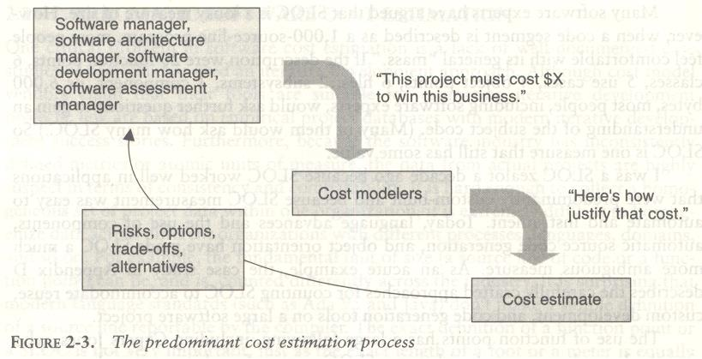
Pragmatic Software Cost Estimation

Slide 67
Improving Software Economics
Five basic parameters of the software cost model
are
Reducing the size or complexity of what needs to be developed.
Improving the development process.
Using more-skilled personnel and better teams (not necessarily the same thing).
Using better environments (tools to automate the process).
Trading off or backing off on quality thresholds

Slide 68
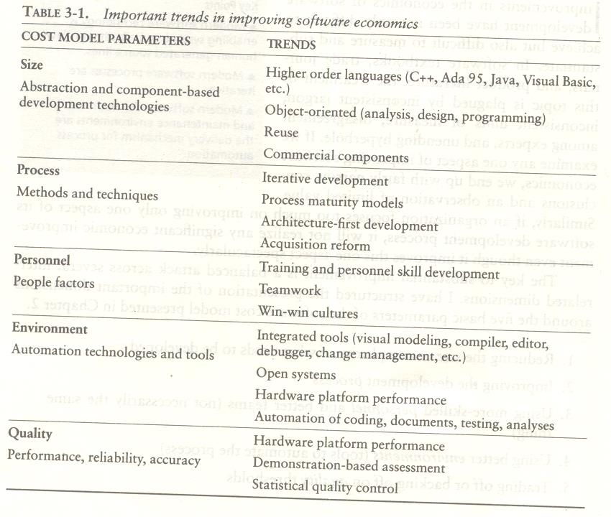

Slide 69
REDUCING SOFTWARE PRODUCT SIZE
The most significant way to improve affordability and return on investment (ROI) is usually to produce a product that achieves the design goals with the minimum amount of human-generated source material.
Component-based development is introduced as the general term for reducing the "source" language size to achieve a software solution.
Reuse, object-oriented technology, automatic code production, and higher order programming languages are all focused on achieving a given system with fewer lines of human-specified source directives (statements).

Slide 70
REDUCING SOFTWARE PRODUCT SIZE
Size reduction is the primary motivation behind improvements in higher order languages (such as C++, Ada 95,Java, Visual Basic), automatic code generators (CASE tools, visual modeling tools, GUI builders).
Reuse of commercial components (operating systems, windowing environments, database management systems, middleware, networks), and object-oriented technologies (Unified Modeling Language, visual modeling tools, architecture frameworks).
The reduction is defined in terms of human-generated source material.
In general, when size-reducing technologies are used, they reduce the number of human-generated source lines.

Slide 71
REDUCING SOFTWARE PRODUCT SIZE
LANGUAGES
Universal function points (UFPs1) are useful estimators for language-independent, early life-cycle estimates.
The basic units of function points are external user inputs, external outputs, internal logical data groups, external data interfaces, and external inquiries.
SLOC metrics are useful estimators for software after a candidate solution is formulated and an implementation language is known.
Substantial data have been documented relating SLOC to function points.

Slide 72
REDUCING SOFTWARE PRODUCT SIZE
OBJECT-ORIENTED METHODS AND VISUAL MODELING
An object-oriented model of the problem and its solution encourages a common vocabulary between the end users of a system and its developers, thus creating a shared understanding of the problem being solved.
The use of continuous integration creates opportunities to recognize risk early and make incremental corrections without destabilizing the entire development effort.
An object-oriented architecture provides a clear separation of concerns among disparate elements of a system, creating firewalls that prevent a change in one part of the system from rending the fabric of the entire architecture.

Slide 73
REDUCING SOFTWARE PRODUCT SIZE
REUSE
Reusing existing components and building reusable components have been natural software engineering activities since the earliest improvements in programming languages.
With reuse in order to minimize development costs while achieving all the other required attributes of performance, feature set, and quality.
Try to treat reuse as a mundane part of achieving a return on investment. Most truly reusable components of value are transitioned to commercial products supported by organizations with the following characteristics:
They have an economic motivation for continued support.
They take ownership of improving product quality, adding new features, and transitioning to new technologies.
They have a sufficiently broad customer base to be profitable.

Slide 74
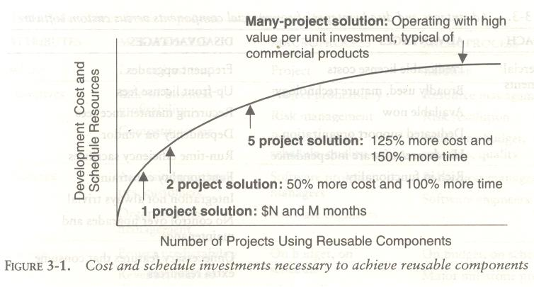

Slide 75
REDUCING SOFTWARE PRODUCT SIZE
COMMERCIAL COMPONENTS
A common approach being pursued today in many domains is to maximize integration of commercial components and off-the-shelf products.
While the use of commercial components is certainly desirable as a means of reducing custom development, it has not proven to be straightforward in practice

Slide 76
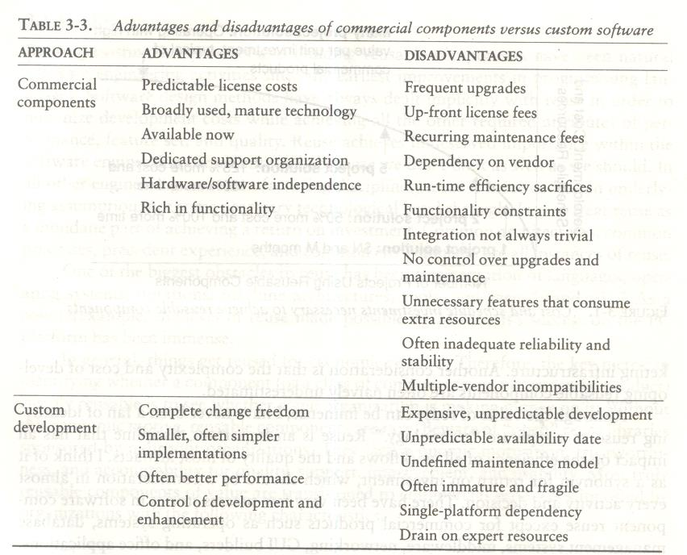

Slide 77
IMPROVING SOFTWARE PROCESSES
Process is an overloaded term. Three distinct process perspectives are.
Metaprocess: an organization's policies, procedures, and practices for pursuing a software-intensive line of business. The focus of this process is on organizational economics, long-term strategies, and software ROI.
Macroprocess: a project's policies, procedures, and practices for producing a complete software product within certain cost, schedule, and quality constraints. The focus of the macro process is on creating an adequate instance of the Meta process for a specific set of constraints.
Microprocess: a project team's policies, procedures, and practices for achieving an artifact of the software process. The focus of the micro process is on achieving an intermediate product baseline with adequate quality and adequate functionality as economically and rapidly as practical.

Slide 78
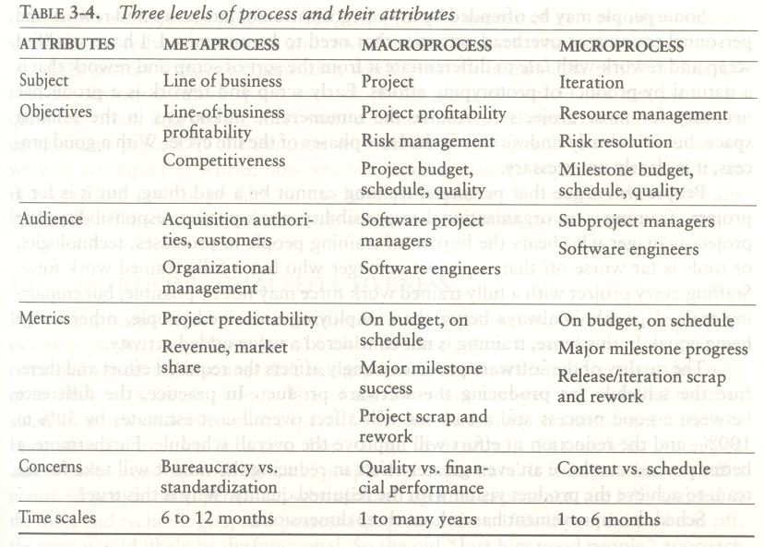
IMPROVING SOFTWARE PROCESSES

Slide 79
IMPROVING TEAM EFFECTIVENESS
Teamwork is much more important than the sum of the individuals.
With software teams, a project manager needs to configure a balance of solid talent with highly skilled people in the leverage positions.
Some maxims of team management include the following:
A well-managed project can succeed with a nominal engineering team.
A mismanaged project will almost never succeed, even with an expert team of engineers.
A well-architected system can be built by a nominal team of software builders.
A poorly architected system will flounder even with an exp

Slide 80
Boehm five staffing principles are
The principle of top talent: Use better and fewer people
The principle of job matching: Fit the tasks to the skills and motivation of the people available.
The principle of career progression: An organization does best in the long run by helping its people to self-actualize.
The principle of team balance: Select people who will complement and harmonize with one another
The principle of phase-out: Keeping a misfit on the team doesn't benefit anyone

Slide 81
Software project managers need many leadership qualities in order to enhance team effectiveness.
The following are some crucial attributes of successful software project managers that deserve much more attention:
Hiring skills. Few decisions are as important as hiring decisions. Placing the right person in the right job seems obvious but is surprisingly hard to achieve.
Customer-interface skill. Avoiding adversarial relationships among stakeholders is a prerequisite for success.
Decision-making skill. The jillion books written about management have failed to provide a clear definition of this attribute. We all know a good leader when we run into one, and decision-making skill seems obvious despite its intangible definition.
Team-building skill. Teamwork requires that a manager establish trust, motivate progress, exploit eccentric prima donnas, transition average people into top performers, eliminate misfits, and consolidate diverse opinions into a team direction.
Selling skill. Successful project managers must sell all stakeholders (including themselves) on decisions and priorities, sell candidates on job positions, sell changes to the status quo in the face of resistance, and sell achievements against objectives. In practice, selling requires continuous negotiation, compromise, and empathy

Slide 82
IMPROVING AUTOMATION THROUGH SOFTWARE ENVIRONMENTS
The tools and environment used in the software process generally have a linear effect on the productivity of the process.
Planning tools, requirements management tools, visual modeling tools, compilers, editors, debuggers, quality assurance analysis tools, test tools, and user interfaces provide crucial automation support for evolving the software engineering artifacts.
Above all, configuration management environments provide the foundation for executing and instrument the process.
At first order, the isolated impact of tools and automation generally allows improvements of 20% to 40% in effort. However, tools and environments must be viewed as the primary delivery vehicle for process automation and improvement, so their impact can be much higher.

Slide 83
The tools and environment used in the software process generally have a linear effect on the productivity of the process.
Planning tools, requirements management tools, visual modeling tools, compilers, editors, debuggers, quality assurance analysis tools, test tools, and user interfaces provide crucial automation support for evolving the software engineering artifacts.
Above all, configuration management environments provide the foundation for executing and instrument the process.
At first order, the isolated impact of tools and automation generally allows improvements of 20% to 40% in effort. However, tools and environments must be viewed as the primary delivery vehicle for process automation and improvement, so their impact can be much higher.

Slide 84
Round-trip engineering describes the key capability of environments that support iterative development.
As we have moved into maintaining different information repositories for the engineering artifacts, we need automation support to ensure efficient and error-free transition of data from one artifact to another.
Forward engineering is the automation of one engineering artifact from another, more abstract representation. For example, compilers and linkers have provided automated transition of source code into executable code.
Reverse engineering is the generation or modification of a more abstract representation from an existing artifact (for example, creating a visual design model from a source code representation).
Economic improvements associated with tools and environments. It is common for tool vendors to make relatively accurate individual assessments of life-cycle activities to support claims about the potential economic impact of their tools.
For example, it is easy to find statements such as the following from companies in a particular tool.

Slide 85
Requirements analysis and evolution activities consume 40% of life-cycle costs.
Software design activities have an impact on more than 50% of the resources.
Coding and unit testing activities consume about 50% of software development effort and schedule.
Test activities can consume as much as 50% of a project's resources.
Configuration control and change management are critical activities that can consume as much as 25% of resources on a large-scale project.
Documentation activities can consume more than 30% of project engineering resources.
Project management, business administration, and progress assessment can consume as much as 30% of project budgets.

Slide 86
ACHIEVING REQUIRED QUALITY
Key practices that improve overall software quality include the following
Focusing on driving requirements and critical use cases early in the life cycle, focusing on requirements completeness and traceability late in the life cycle, and focusing throughout the life cycle on a balance between requirements evolution, design evolution, and plan evolution
Using metrics and indicators to measure the progress and quality of an architecture as it evolves from a high-level prototype into a fully compliant product
Providing integrated life-cycle environments that support early and continuous configuration control,change management, rigorous design methods, document automation, and regression test automation
Using visual modeling and higher level languages that support architectural control, abstraction, reliable programming, reuse, and self-documentation
Early and continuous insight into performance issues through demonstration-based evaluations

Slide 87
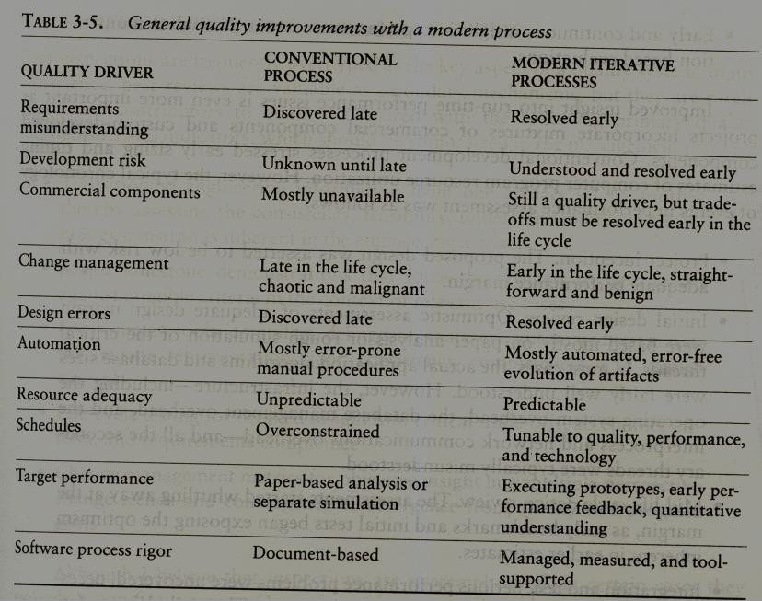
ACHIEVING REQUIRED QUALITY

Slide 88
ACHIEVING REQUIRED QUALITY
Conventional development processes stressed early sizing and timing estimates of computer program resource utilization. However, the typical chronology of events in performance assessment was as follows,
Project inception. The proposed design was asserted to be low risk with adequate performance margin.
Initial design review. Optimistic assessments of adequate design margin were based mostly on paper analysis or rough simulation of the critical threads. In most cases, the actual application algorithms and database sizes were fairly well understood.
Mid-life-cycle design review. The assessments started whittling away at the margin, as early benchmarks and initial tests began exposing the optimism inherent in earlier estimates.
Integration and test. Serious performance problems were uncovered, necessitating fundamental changes in the architecture. The underlying infrastructure was usually the scapegoat, but the real culprit was immature use of the infrastructure, immature architectural solutions, or poorly understood early design trade-offs.

Slide 89
PEER INSPECTIONS: A PRAGMATIC VIEW
Peer inspections are frequently over hyped as the key aspect of a quality system. In my experience, peer reviews are valuable as secondary mechanisms, but they are rarely significant contributors to quality compared with the following primary quality mechanisms and indicators, which should be emphasized in the management process:
Transitioning engineering information from one artifact set to another, thereby assessing the consistency, feasibility, understandability, and technology constraints inherent in the engineering artifacts
Major milestone demonstrations that force the artifacts to be assessed against tangible criteria in the of relevant use cases
Environment tools (compilers, debuggers, analyzers, automated test suites) that ensure representation rigor, consistency, completeness, and change control
Life-cycle testing for detailed insight into critical trade-offs, acceptance criteria, and requirements compliance
Change management metrics for objective insight into multiple-perspective change trends and convergence or divergence from quality and progress goals.
Inspections are also a good vehicle for holding authors accountable for quality products. All authors of software and documentation should have their products scrutinized as a natural by-product of the process. Therefore, the coverage of inspections should be across all authors rather than across all components.

